Slide 1
Environmental impact of the tunnel construction
Zabarovskii R.

Slide 2
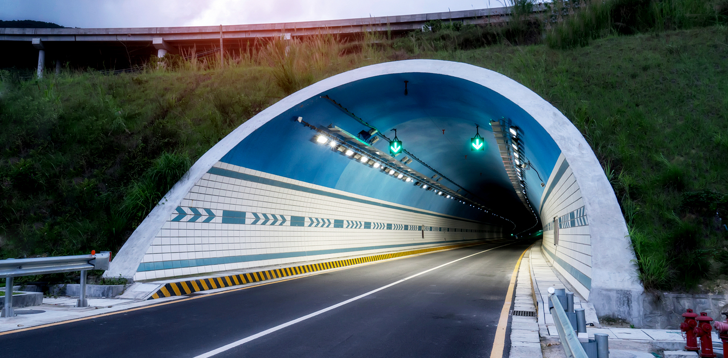
Object of research: traffic tunnels at combined road

Slide 3
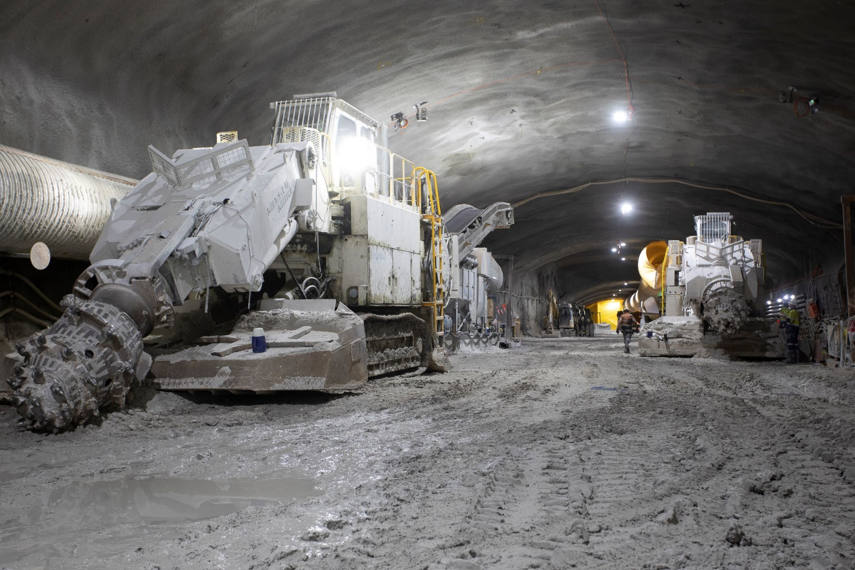
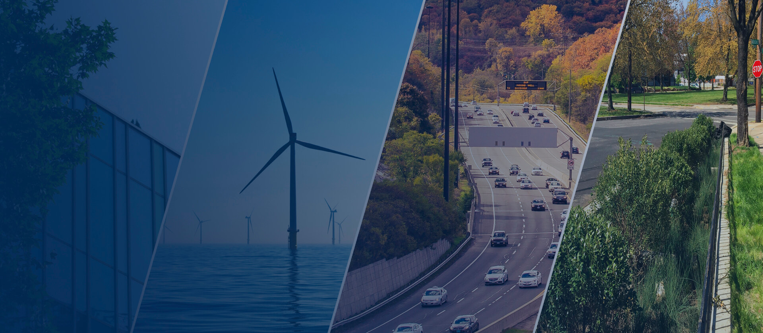
Characteristics of such impact during the construction period

Slide 4



Slide 6

Conclusion

